Slide 1

StyleHive
Team 3

Slide 2

StyleHive GitHub URL
https://github.com/Capstone-pace-team3/stylehive

Slide 3
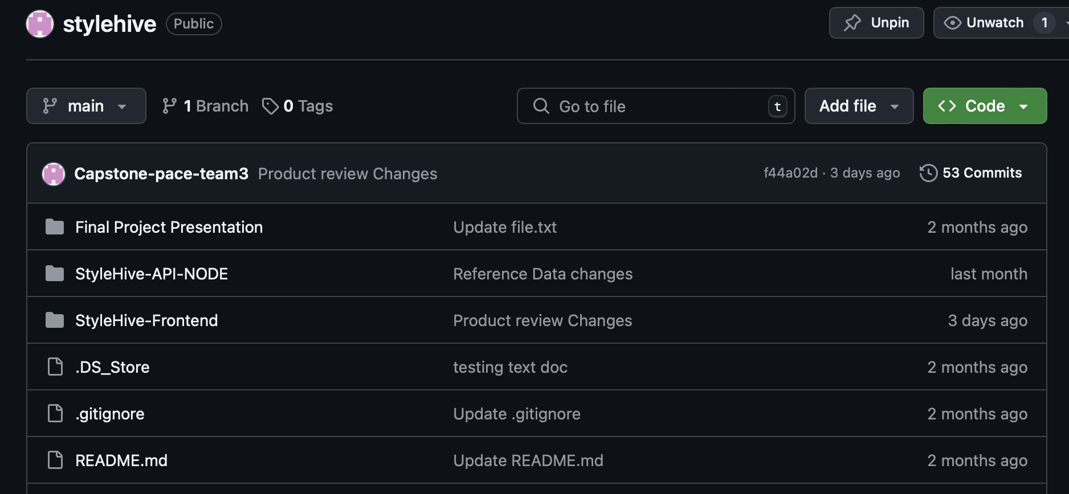
Repository Structure
“
”

Slide 4
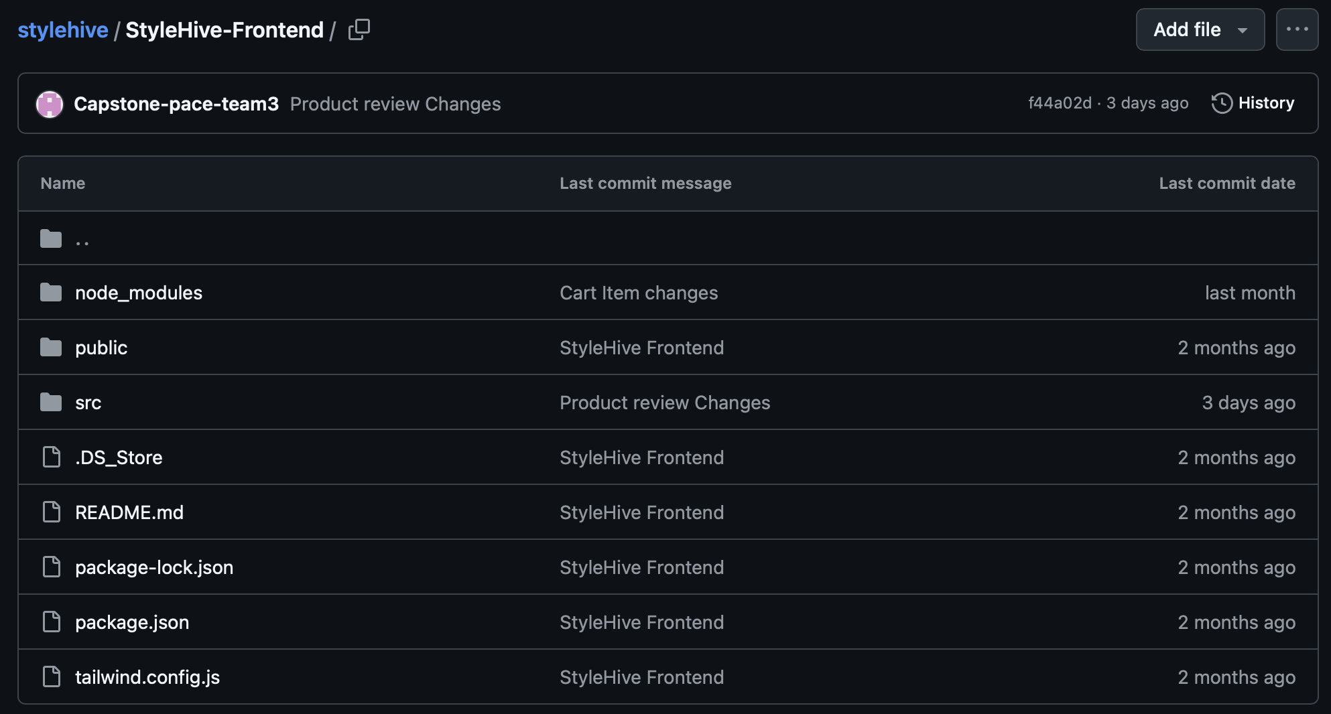
Repository Structure - Frontend
“
”

Slide 5
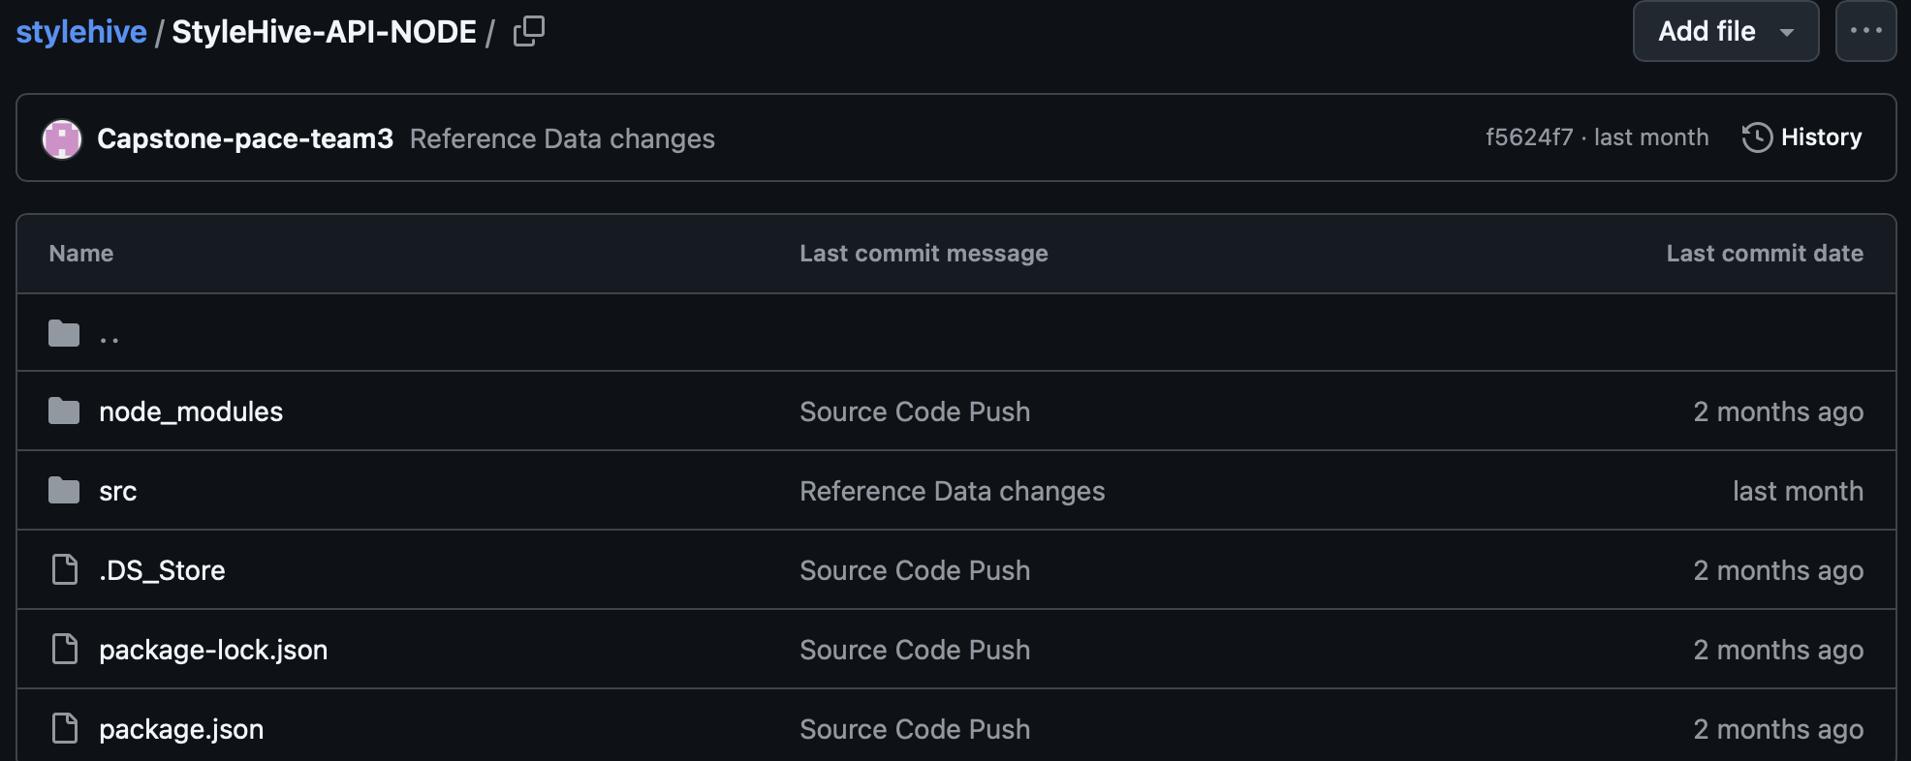
Repository Structure - Backend
“
”

Slide 6

Build & Deployment Procedures

Slide 7

Prerequisites:
Node.js and React.js must be installed on your local machine
Installation Steps:
Clone the repository to your local machine
Open the StyleHive-Frontend folder in command line and run the following command: npm start
Open the StyleHive-API-NODE folder in command line and run the following command: npm run dev

Slide 8
Source Code Excerpts
“
Two Features
Add Items to Cart – Order Management Module
Process Payments – Finance Management Module
”

Slide 9
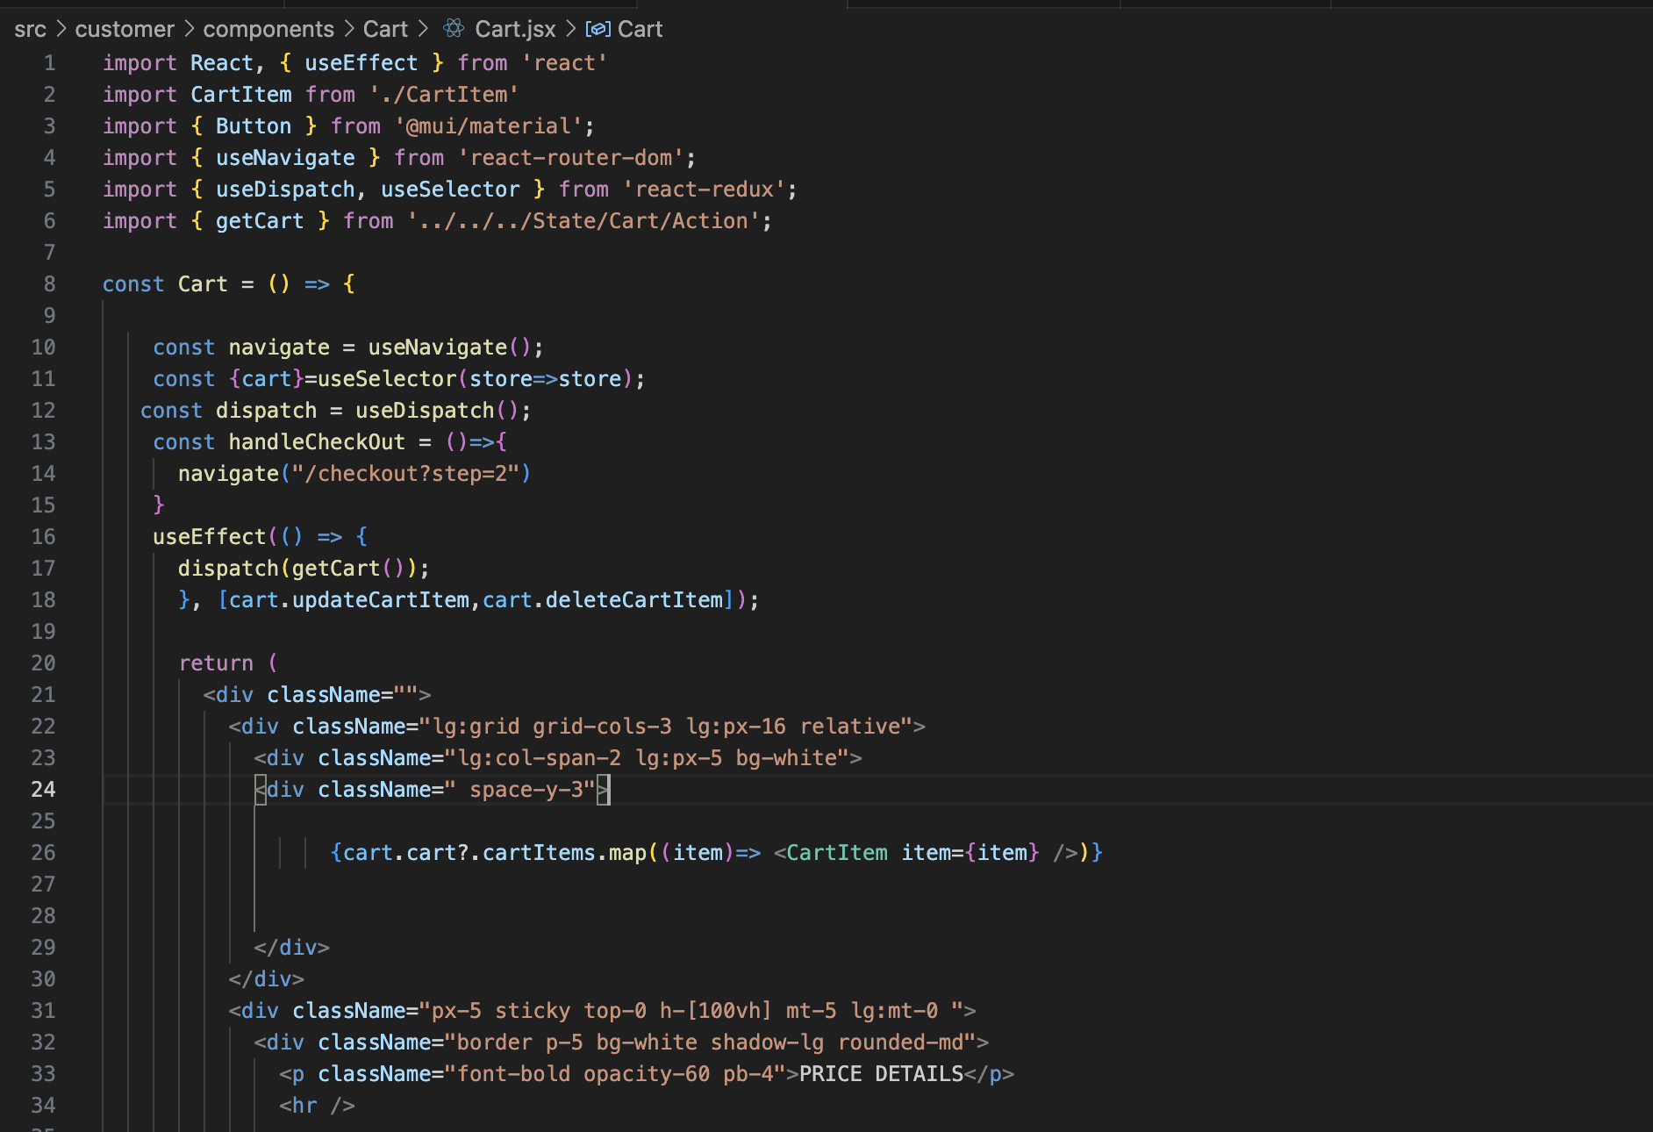
Feature: Add Items to Cart – Frontend
“
”

Slide 10
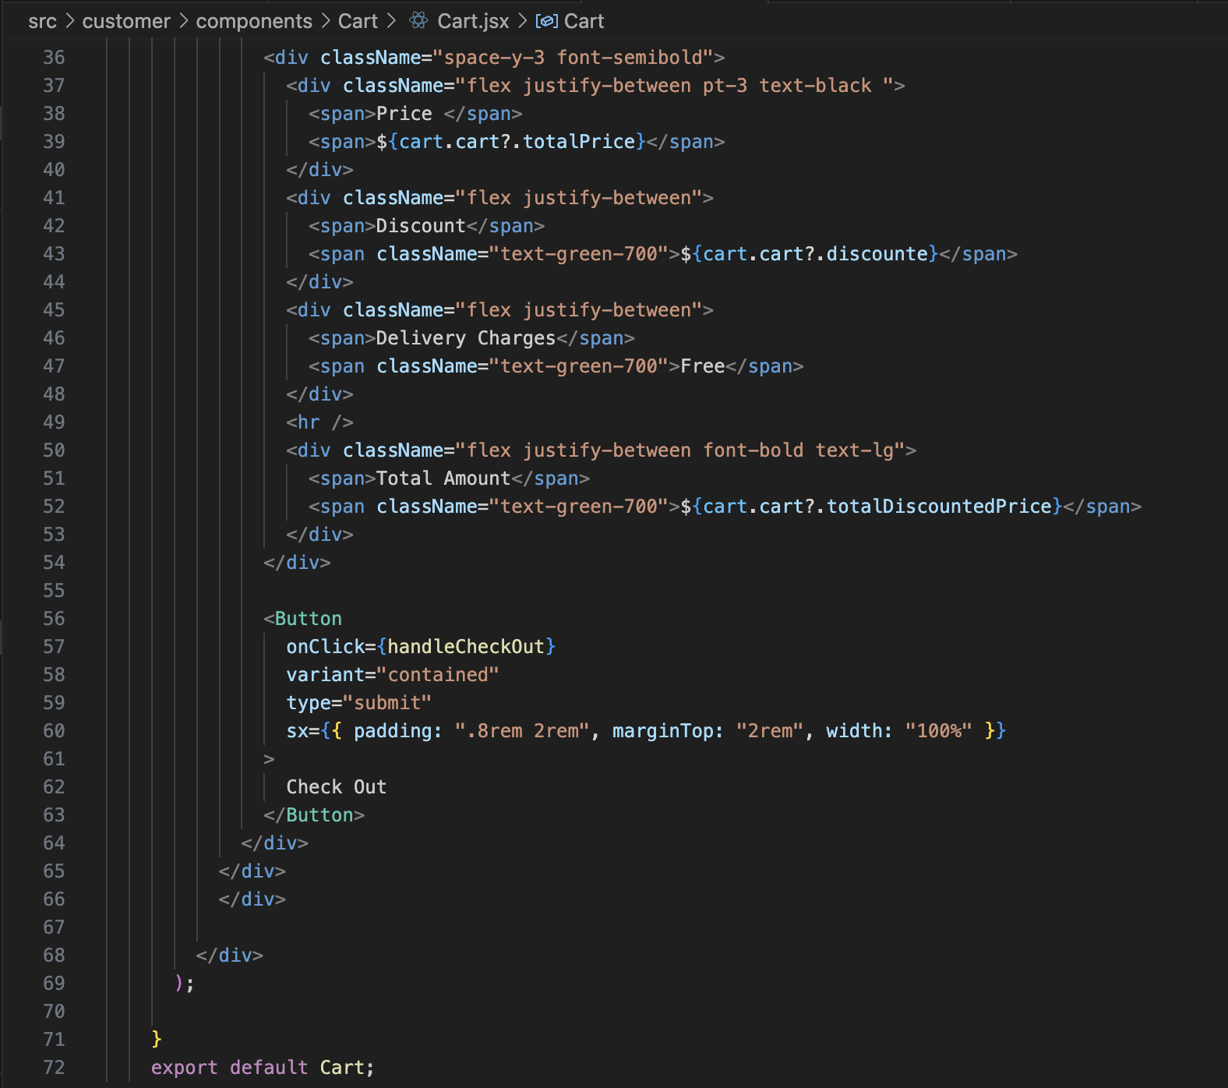
Feature: Add Items to Cart – Frontend
“
”

Slide 11
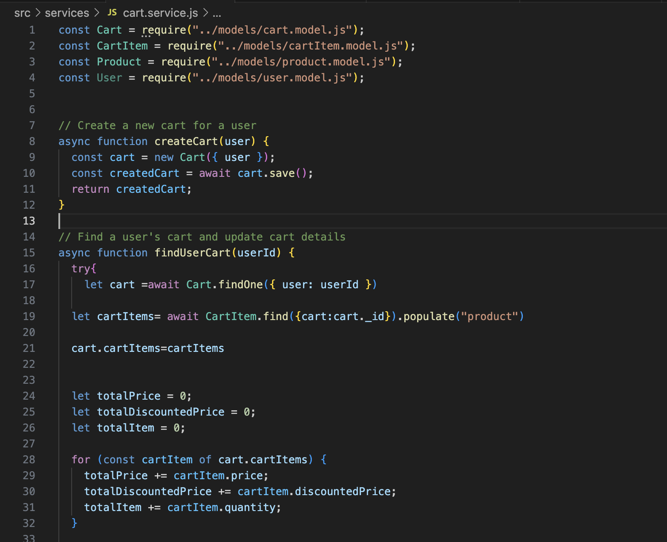
Feature: Add Items to Cart – Backend
“
”

Slide 12
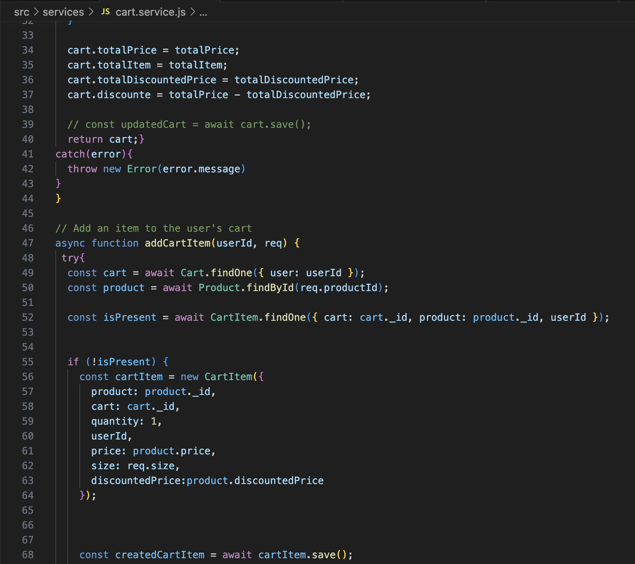
Feature: Add Items to Cart – Backend
“
”

Slide 13
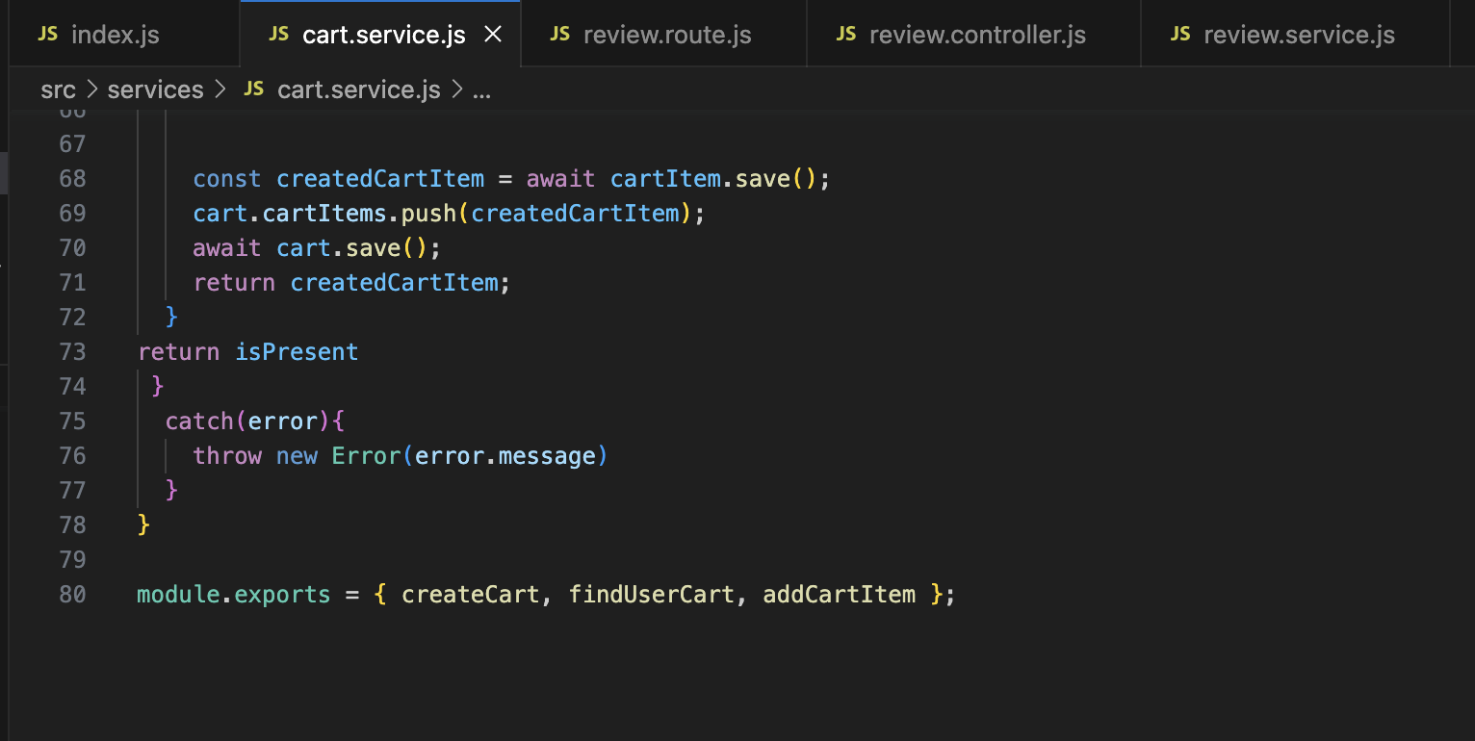
Feature: Add Items to Cart – Backend
“
”

Slide 14
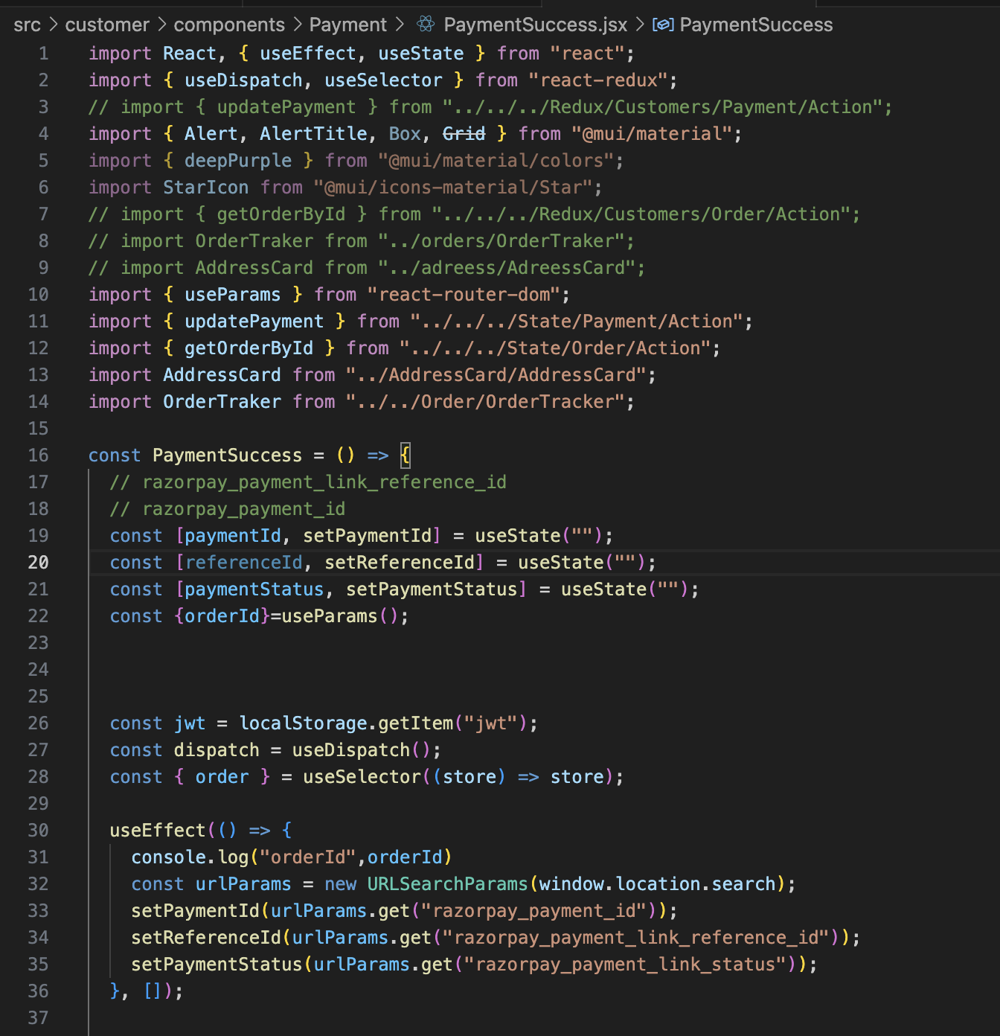
Feature: Process Payments – Frontend
“
”

Slide 15
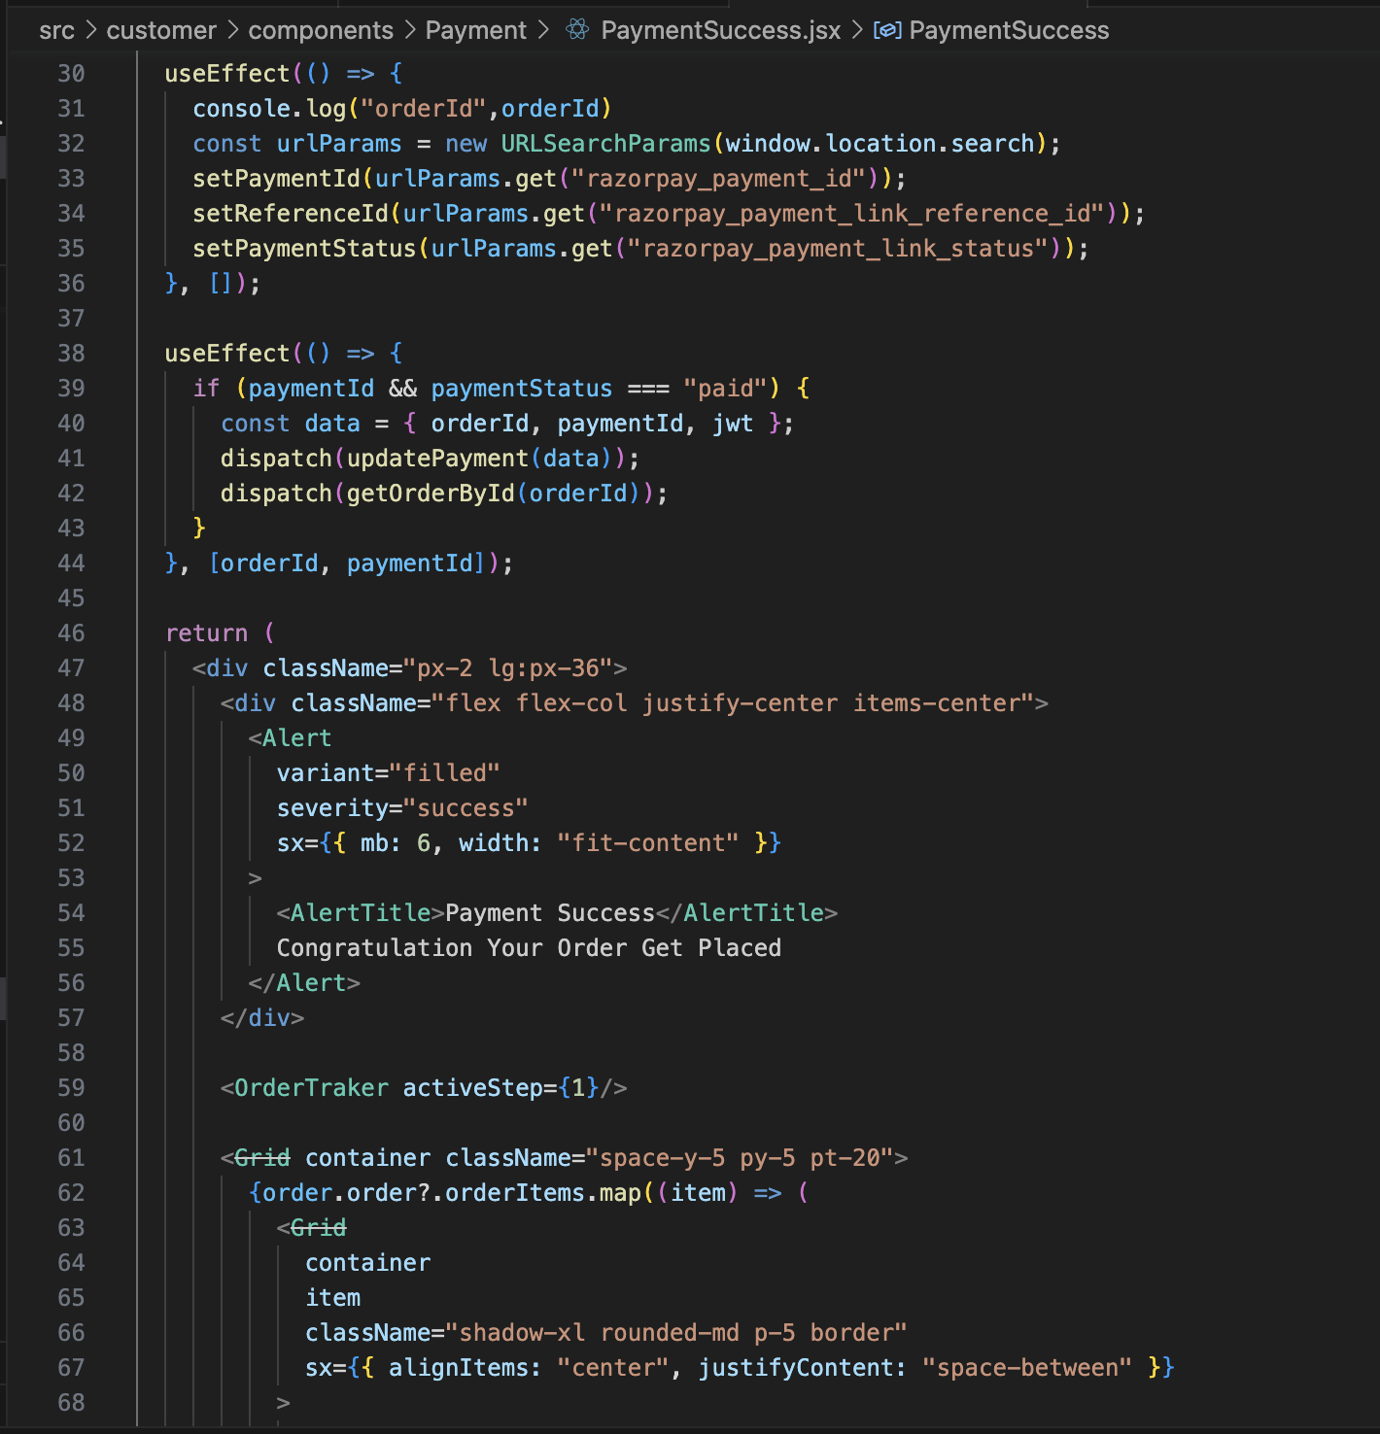
Feature: Process Payments – Frontend
“
”

Slide 16
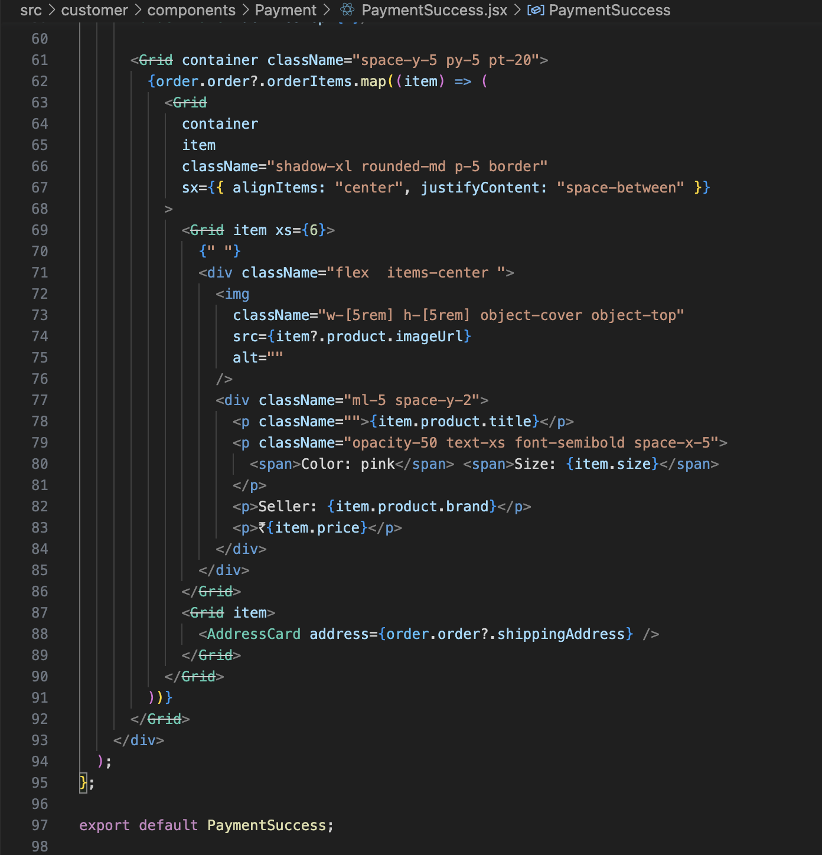
Feature: Process Payments – Frontend
“
”

Slide 17
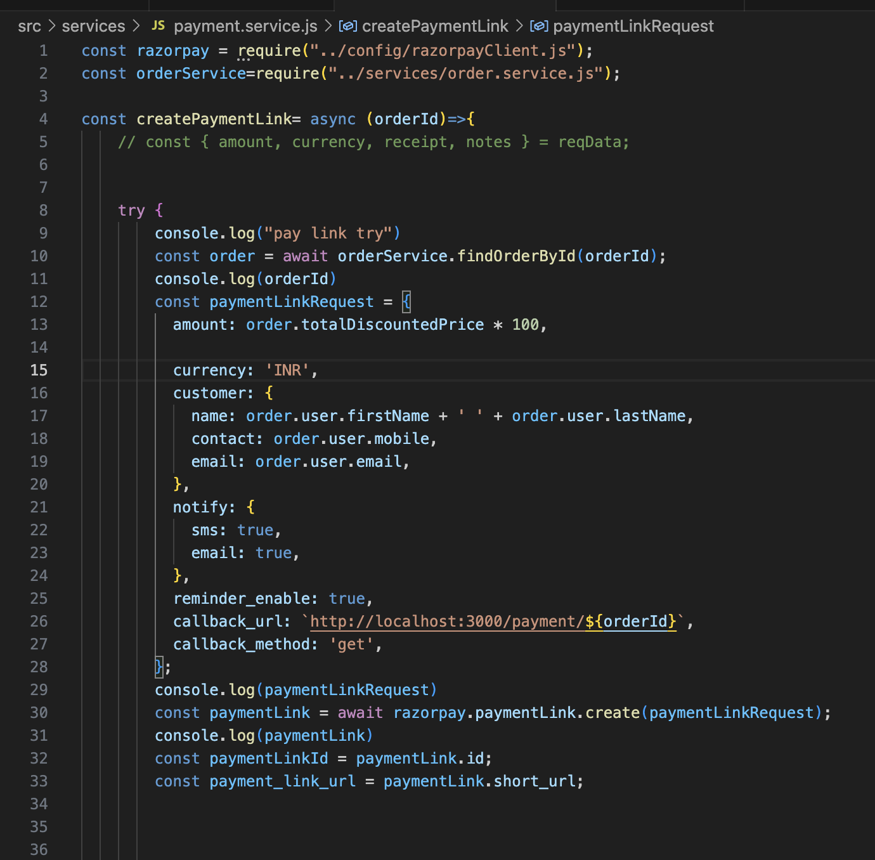
Feature: Process Payments – Backend
“
”

Slide 18
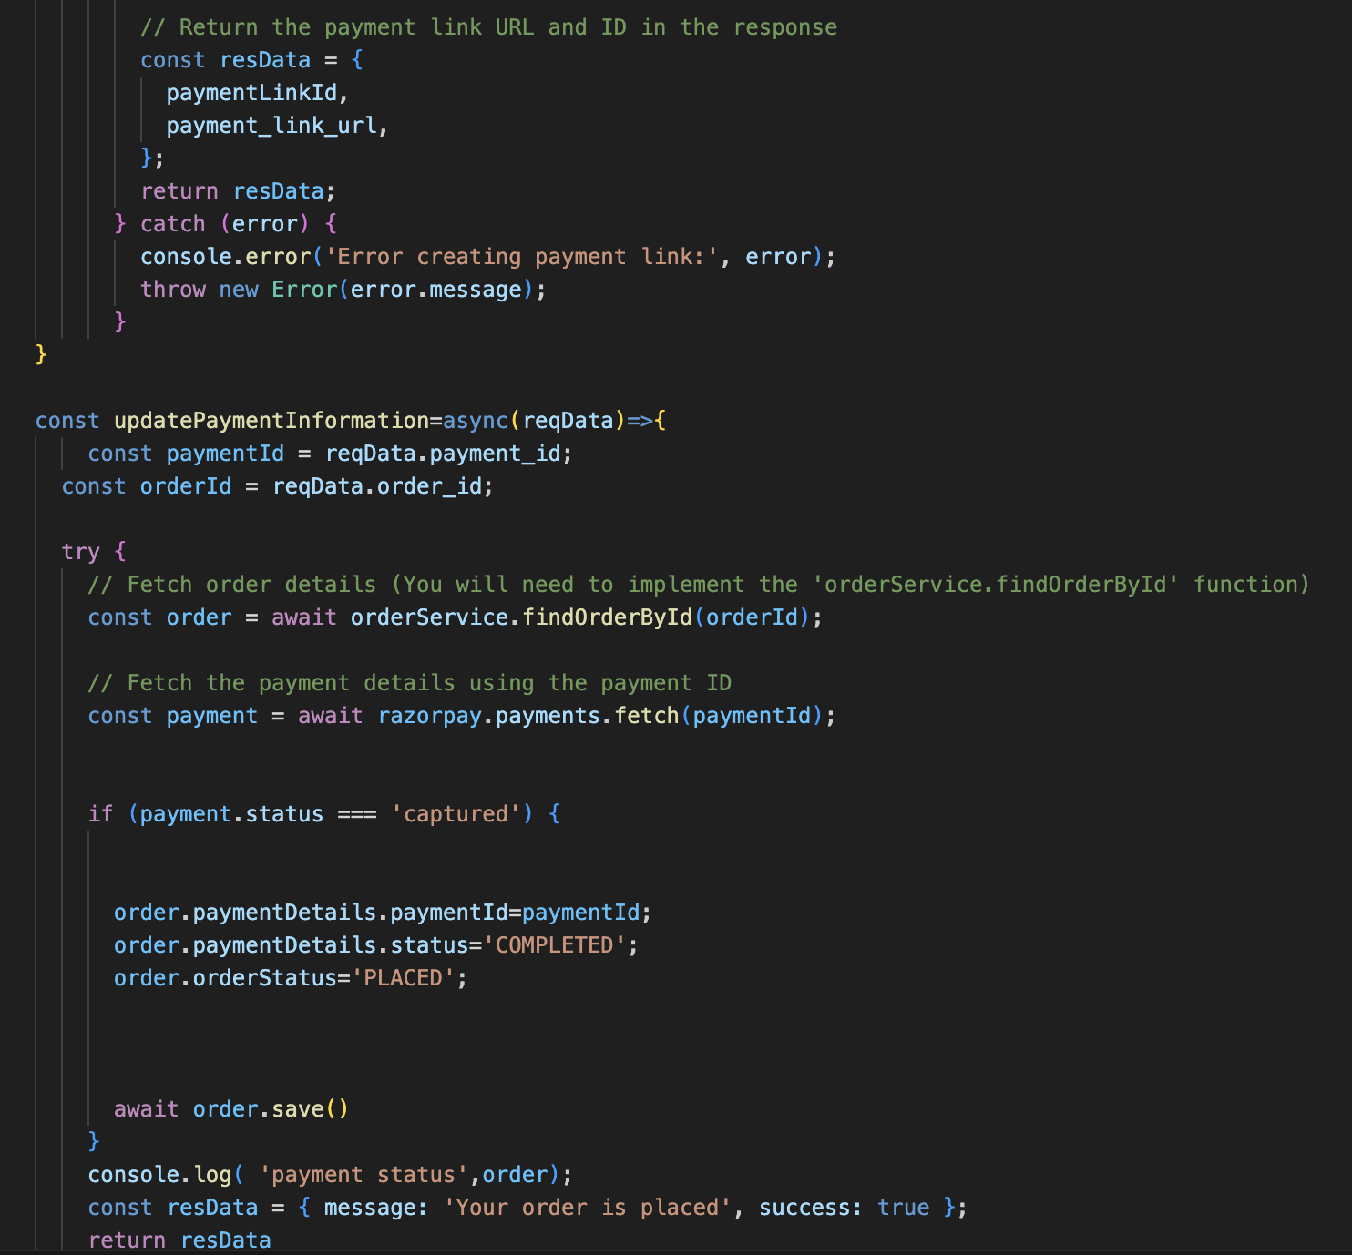
Feature: Process Payments – Backend
“
”

Slide 19
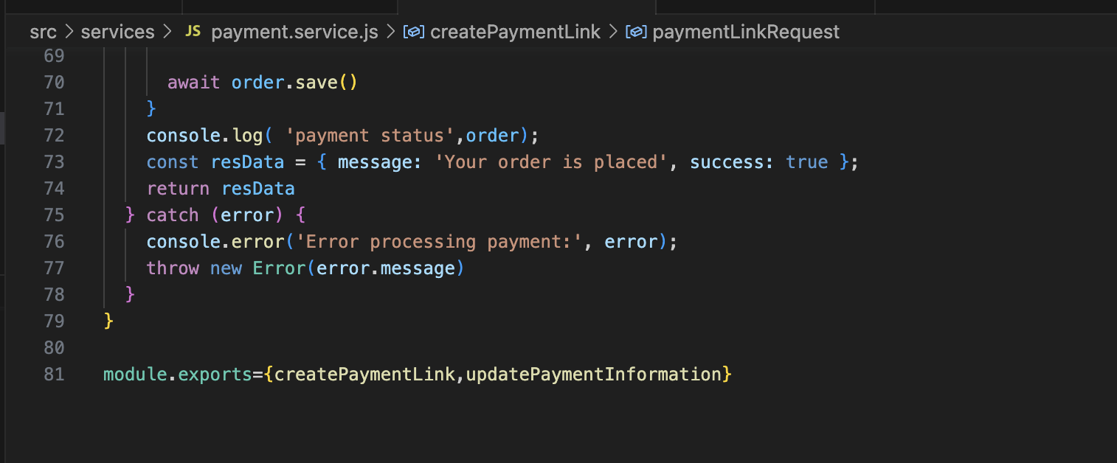
Feature: Process Payments – Backend
“
”

Slide 20
Thank You

